Slide 1

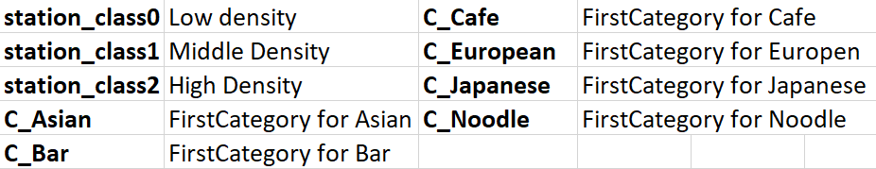
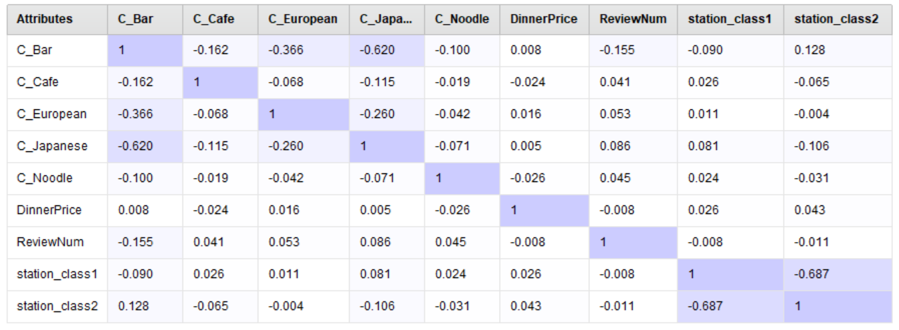
Classify Restaurant Rate Xiaojun zhu, Jhao-Han Chen, Haiping Sun Instructor: Amir H Gandomi
Business Intelligence & Analytics
Introduction
In our daily life, people often use mobile applications to view a restaurant's rating and decide which restaurant to eat. Therefore, figuring out which variables have a greater impact on restaurant rating is important for entrepreneurs while starting a restaurant. The goal of our project is to find the best classified method to discriminate the good and the bad restaurant according to the variables in the dataset we used.
Model
Our group test four classification machine learning algorithms to build model including Logistic Regression, Naïve Bayes, K-Nearest Neighbors and LDA.
Experiment
Data Collection
Our data comes from website Kaggle and the original dataset includes 11 features such as restaurant category, station, Review Number, Dinner Rating, Dinner Price and so on.
Here is the explanation of some features
Data Cleaning
Firstly, as we process the raw data, we found that categories such as BBQ, Mexico and Seafood are rare, so we delete those data.
Then, to make it easier to
analysis, we separate variables
‘station’ and ‘ First Category’
into dummy variables.
Finally, as our target cell is dinner rating, we take the rating more than 3.07, which is the median of the rating, as good restaurant and rating less than 3.07 as bad restaurant.
Feature Selection
After cleaning the data, we generate a correlation coefficient matrix to see which factor should we use in our analysis. The result shows that variables “station_class1” and “station_class2”, variables “C_Bar” and “C_Japanese” have high correlation which are greater than 0.5, so we decide to drop variables “station_class1” and ”C_Japanese”.
Result
By testing the accuracy of
several models, we finally
decide to use KNN to fit our
data set. Also while k=5, the
Model has the highest
accuracy rate.
we randomly choose 10 restaurants to test our model
The result of the
classification have high
accuracy rate based on
our model.
Conclusion
We achieve AUC of up to 0.8601 by using KNN model.
KNN algorithm is sensitive to distance between variables, therefore it is better to normalize the feature
http://www.stevens.edu/bia

